Slide 1
Models for Organization of Threads
Dhara Tamhane
Femina Shah
Krima Shah
Malavika Iyer

Slide 2
Summary & Outline
Threads are integral part of operating system. Creating and destroying threads, synchronization between them and scheduling among them are some key features of operating systems which we will be dealing with in this project.
This project will help us in gaining a deep understanding of issues related to threads and developing applications using multithreading.
We examine the 3 models for organization of threads. They are:
Dispatcher-Worker Model
Team Model
Pipeline Model

Slide 3
Purpose
Threads work according to certain methodologies. These distinct models are applied to meet the requirements of an application.
The main goal of the project is to implement the different models for organization of threads.
We study these models in order to understand their properties and understand how these models must be applied to different applications.
We also look at:
Implementation of each of the models
Advantages and disadvantages of each model
Variations in implementation associated with each model

Slide 4
Single Thread or Multiple Threads?
Is a single thread enough for a complex process?
Does using only one thread cause drawbacks?
Why do we need multiple threads?
Does having multiple threads improve performance?

Slide 5
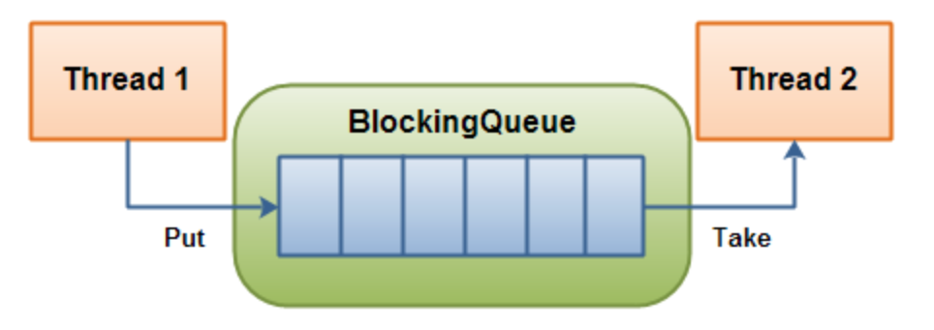
Thread Safe Queues
A thread safe queue waits for the queue to become non-empty while retrieving an element and waits for a space to become available in the queue when storing an element.
Blocking Queue is an implementation of thread safe queue.
A Blocking Queue is used when objects produced by one thread are consumed by another thread.
A Blocking Queue can be implemented as an array or a linked list based on the requirement of the application.

Slide 6
Dispatcher-Worker Model
Threads
Dispatcher
Jobs

Slide 7
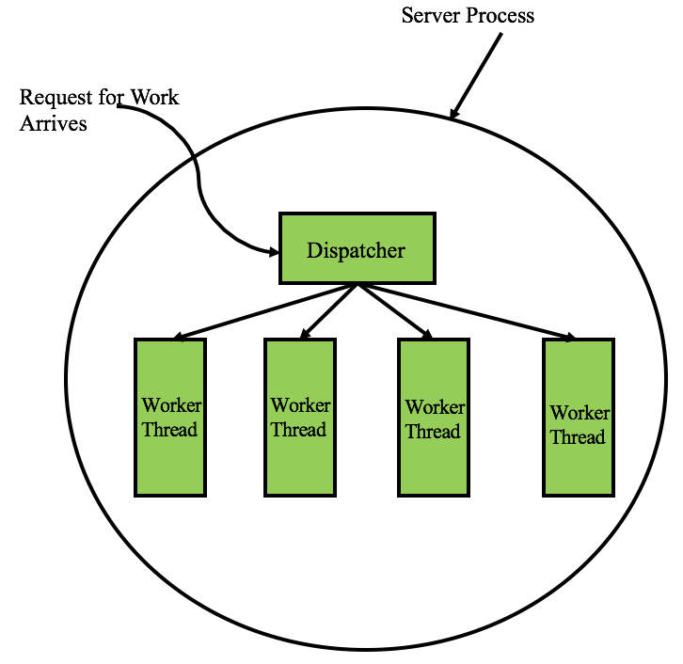
Dispatcher-Worker Model
Also called the Boss / Worker and Master / Slave model.
The dispatcher creates the worker threads and places the jobs in a queue.
Each worker thread retrieves a job from the queue and executes it.
When the current job is done it looks for another job. If a job is not available the worker thread suspends itself.

Slide 8
Dispatcher-Worker Model
Thread 1
Sleeping
Dispatcher
Thread 2
Sleeping
Thread 3
Sleeping

Slide 9
Dispatcher-Worker Model
Thread 1
Sleeping
Job 1
Dispatcher
Thread 2
Sleeping
Thread 3
Sleeping

Slide 10
Dispatcher-Worker Model
Thread 1
Sleeping
Job 1
Wake Up
Dispatcher
Thread 2
Sleeping
Thread 3
Sleeping

Slide 11
Dispatcher-Worker Model
Thread 1
Sleeping
Dispatcher
Job 1
Thread 2
Sleeping
Thread 3
Sleeping

Slide 12
Dispatcher-Worker Model
Thread 1
Job 2
Dispatcher
Job 1
Thread 2
Sleeping
Thread 3
Sleeping

Slide 13
Dispatcher-Worker Model
Thread 1
Job 2
Job 1
Dispatcher
Job 1
Wake Up
Thread 2
Sleeping
Thread 3
Sleeping

Slide 14
Dispatcher-Worker Model
Thread 1
Job 1
Dispatcher
Job 1
Thread 2
Sleeping
Job 2
Thread 3
Sleeping

Slide 15
Dispatcher-Worker Model
Thread 1
Job 3
Dispatcher
Job 1
Thread 2
Job 2
Thread 3
Sleeping

Slide 16
Dispatcher-Worker Model
Thread 1
Job 3
Dispatcher
Job 1
Thread 2
Wake Up
Job 2
Thread 3
Sleeping

Slide 17
Dispatcher-Worker Model
Thread 1
Dispatcher
Job 1
Thread 2
Job 2
Job 3
Thread 3
Sleeping

Slide 18
Dispatcher-Worker Model
I’m done. Going to sleep
Thread 1
Sleeping
Dispatcher
Thread 2
Job 2
Thread 3
Job 3

Slide 19
Dispatcher-Worker Model
Thread 1
Sleeping
Job 4
Dispatcher
Thread 2
Job 2
Thread 3
Job 3

Slide 20
Dispatcher-Worker Model
Thread 1
Sleeping
Job 4
I’m done. Going to sleep
Wake up
There’s work
Dispatcher
Thread 2
Sleeping
Thread 3
Job 3

Slide 21
Dispatcher-Worker Model
Thread 1
Sleeping
Dispatcher
Job 4
Thread 2
Sleeping
Thread 3
Job 3

Slide 22
Dispatcher-Worker Model
Thread 1
Dispatcher
Job 4
Thread 2
Sleeping
Thread 3
Job 3

Slide 23
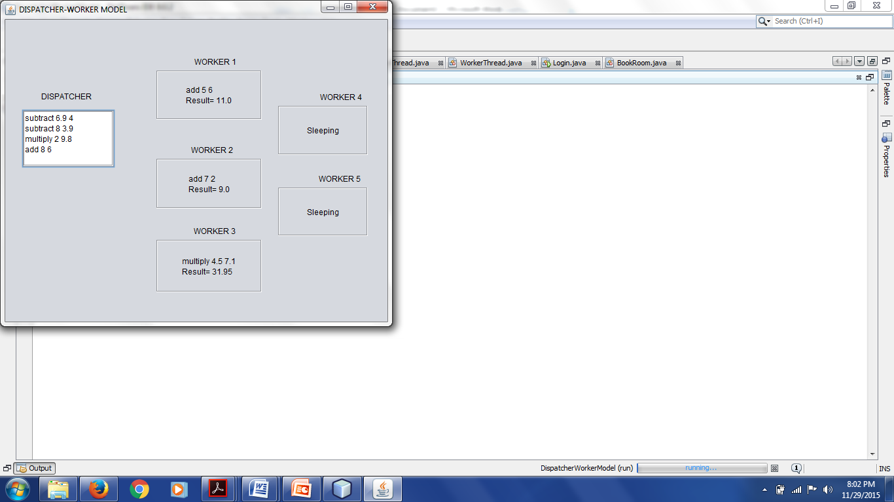
Demo

Slide 24
Implementation Variations of Dispatcher-Worker Model
Event loop to check requests
New worker for each request
Each new request assigned to a worker
2 approaches
Fixed number of worker threads
Tasks requests in queue
Worker completes task and checks queue for new requests
No request, then sleep till next request

Slide 25
Why is it optimal for Dispatcher-Worker Model?
Web Server
The dispatcher thread performs an infinite loop for performing a work request and assigning it to a worker.
The worker thread performs an infinite loop of accepting a work request from the dispatcher and checking the Web cache to check if the page is present.

Slide 26
Team Model

Slide 27
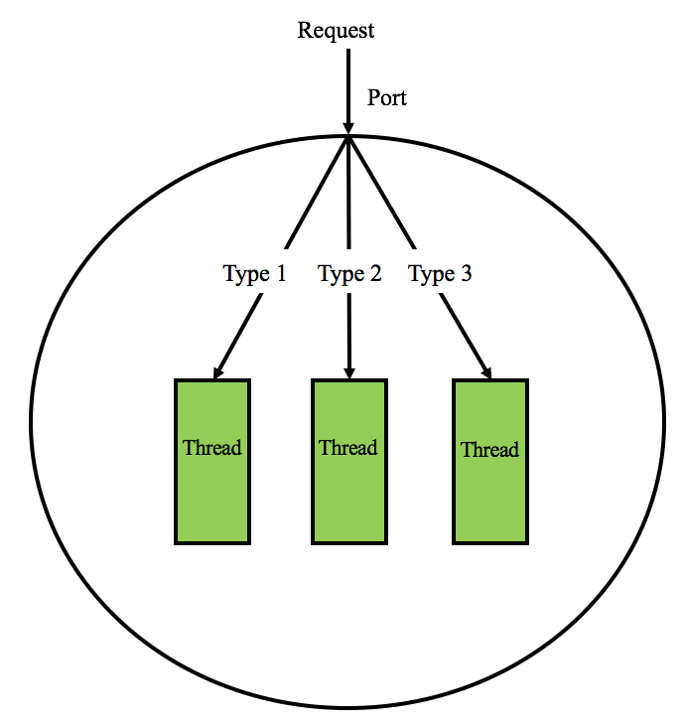
Team Model
Also called Peer-To-Peer and Work-Crew model.
Each thread behaves independently while processing the respective input data.
All the threads work on their data concurrently.
There is no centralized control among the threads.

Slide 28
Team Model
Thread 1
Thread 2
Thread 3
Thread 4

Slide 29
Team Model
Thread 1
Thread 2
Job 1
Thread 3
Thread 4

Slide 30
Team Model
Job 1 is my type. I’ll do it
Thread 1
Thread 2
Job 1
Thread 3
Thread 4

Slide 31
Team Model
Thread 1
Thread 2
Job 1
Job 2
Job 3
Thread 3
Thread 4

Slide 32
Team Model
Thread 1
Thread 2
Job 2
Job 1
Job 3
Thread 3
Job 3 is my type. I’ll do it
Job 2 is my type. I’ll do it
Thread 4

Slide 33
Team Model
Thread 1
Thread 2
Job 1
Job 4
Job 5
Thread 3
Thread 4
Job 3
Job 2

Slide 34
Team Model
Thread 1
Job 4 is my type. I’ll do it
Thread 2
Job 1
Job 4
Job 5
Thread 3
Thread 4
Job 5 is my type. I’ll do it
Job 3
Job 2

Slide 35
Team Model
Thread 1
Thread 2
Job 1
Job 4
Thread 3
Thread 4
Job 2
Job 3
Job 5

Slide 36
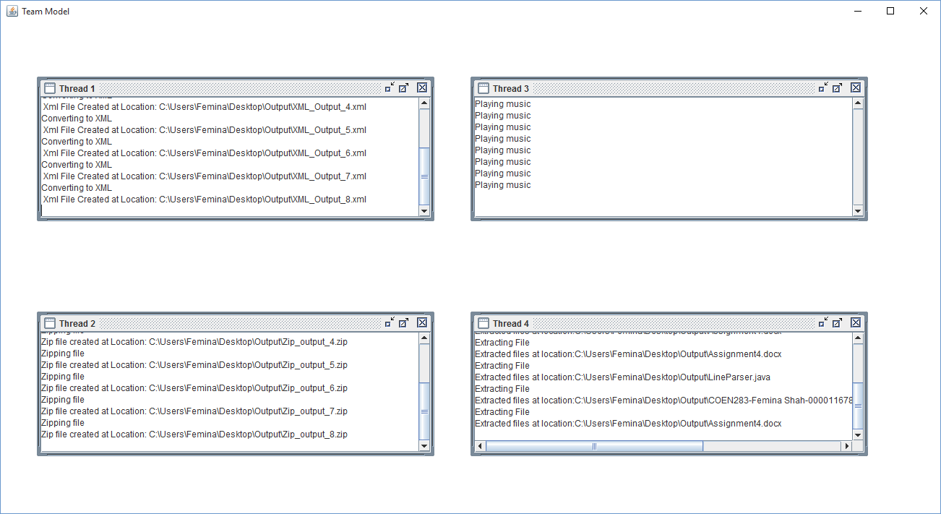
Demo

Slide 37
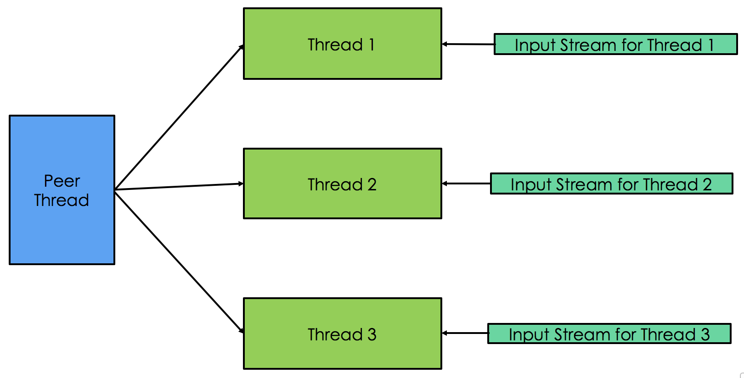
Implementation Variations of Team Model
Each thread has its own dedicated input stream.
Each thread separately works on a task based on the independent input received from its input stream.

Slide 38

Why is it optimal for Team Model?
Word Processing
Specialized threads each perform a specific task.
One thread waits for input, another thread does the reformatting of data and the third thread periodically saves the state of the document.

Slide 39
Pipeline Model

Slide 40
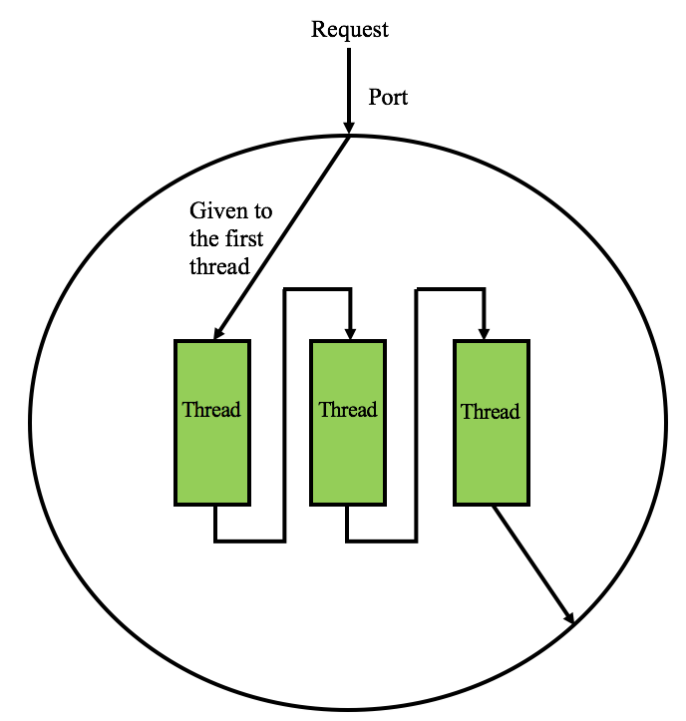
Pipeline Model
The input for the process is given to the first thread.
Once the first thread finishes processing for the input, the output of this thread is given to the second thread.
This continues till the last thread processes the input from its previous thread and gives the output for the process.

Slide 41
Pipeline Model
New data from Process 1
Data from P1
Stage 1

Slide 42
Pipeline Model
Data being processed in Stage 1
Data from P1
Stage 1

Slide 43
Pipeline Model
New data from Process 2
Data from P2
Data from P1
Output of Process 1 from the First Stage
Stage 1
Stage 2

Slide 44
Pipeline Model
Data being processed in Stage 1
Data being processed in Stage 2
Data from P2
Data from P1
Stage 1
Stage 2

Slide 45
Pipeline Model
New data from Process 3
Data from P3
Data from P2
Data from P1
Output of Process 2 from the First Stage
Output of Process 1 from the Second Stage
Stage 1
Stage 2
Stage 3

Slide 46
Pipeline Model
Data being processed in Stage 1
Data being processed in Stage 2
Data being processed in Stage 3
Data from P3
Data from P2
Data from P1
Stage 1
Stage 2
Stage 3

Slide 47
Pipeline Model
Output of Process 3 from First Stage
Output of Process 2 from Second Stage
Data from P3
Data from P2
Stage 1
Stage 2
Stage 3
Output
Output for Process 1

Slide 48
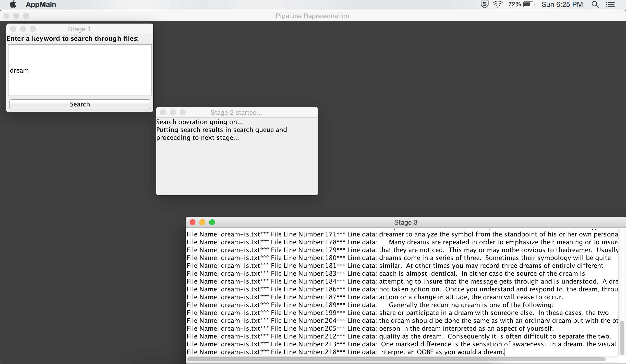
Demo

Slide 49
Implementation Variations of Pipeline Model
Parallel Pipeline Computation Model
The input to the first task is obtained input devices and the inputs to the rest of the tasks in the pipeline are the outputs of their previous tasks.
The same pipeline is repeated on subsequent input data sets.
Each block in the pipeline represents one parallel task, which itself is parallelized on multiple compute nodes.

Slide 50
Why is it optimal for Pipeline Model?
DLX Architecture for CPU
The basic instruction pipeline is broken up into a series or a pipeline.
The stages of the pipeline are:
Instruction Fetch (IR)
Instruction Decode (ID)
Execution (EX)
Memory Access (MEM)
Write-Back (WB)
Each instruction is split up into a sequence of steps so different steps can be executed in parallel and instructions can be processed concurrently.
Each stage takes as much time as the slowest one, even if it does not need this much time to complete.

Slide 51
Advantages & Disadvantages
Model | Advantages | Disadvantages
Dispatcher-Worker | Maximum utilization of worker threads since threads can perform any type of job. Threads can be recycled and reused. Failure of one thread does not affect the performance of other threads. | There is contention for resources if there are interdependencies between threads. May consume extra CPU cycles to perform infinite loop while waiting for new requests.
Team | Each thread has a specialized function. Failure of one thread does not affect the performance of other threads. Easily scalable- more threads can be added. No thread knows about the working of another thread- no interference between threads. | One particular thread can be overloaded due to high number of jobs while other threads remain idle.
Pipeline | Trivial synchronization. Overhead for creation of threads is minimum. | Throughput may be reduced due to a slow moving thread. Failure of one thread will lead to overall process failure.

Slide 52
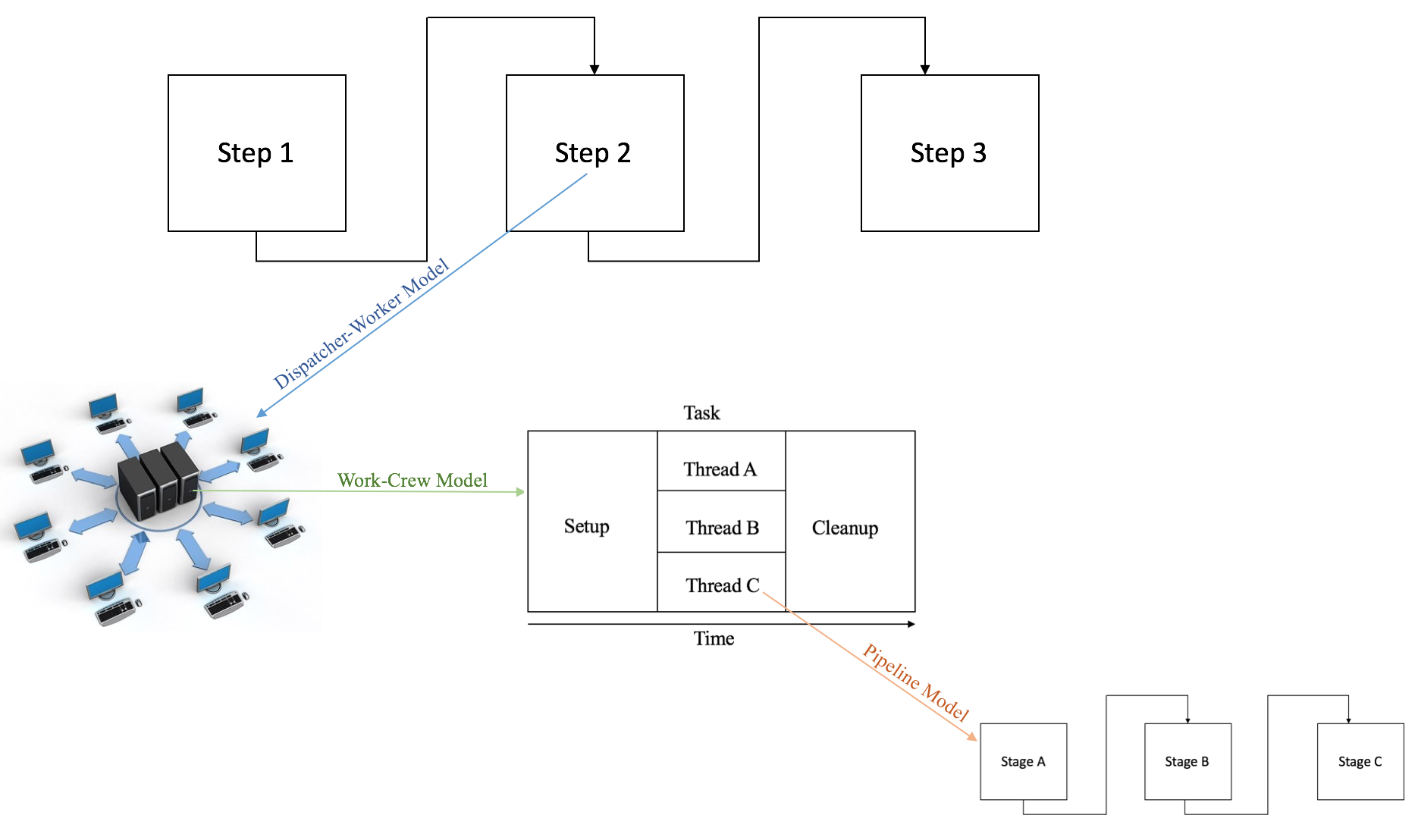
Conclusion
Each model is effective by itself according to the respective applications but models can also be combined.
Different models can be combined in arbitrary ways and beyond recognition to fit individual, complex applications.
For example, a step in a pipeline could involve requesting a service from a server thread, and the server might use a work crew, and one or more workers in the crew might use a pipeline.

Slide 53
References
Distributed Operating Systems by Andrew Tannenbaum
Multithreading - An Efficient Technique for Enhancing Application Performance by Mrs. M. Shanthi and Dr. A. Anthony Irudhayaraj
Distributed Operating Systems: Concepts and Design by Pradeep K. Sinha
Programming with POSIX Thread by David R. Butenof
Understanding Operating Systems 6 by Ann McIver McHoes and Ida M. Flynn
Implementing Thread Priorities in a HTTP Server by Soumith Chintala, Yuri Soussov, Randolph Chiu Tan, New York University

Slide 54
Questions?

Slide 55
Thank You!

